Slide 1
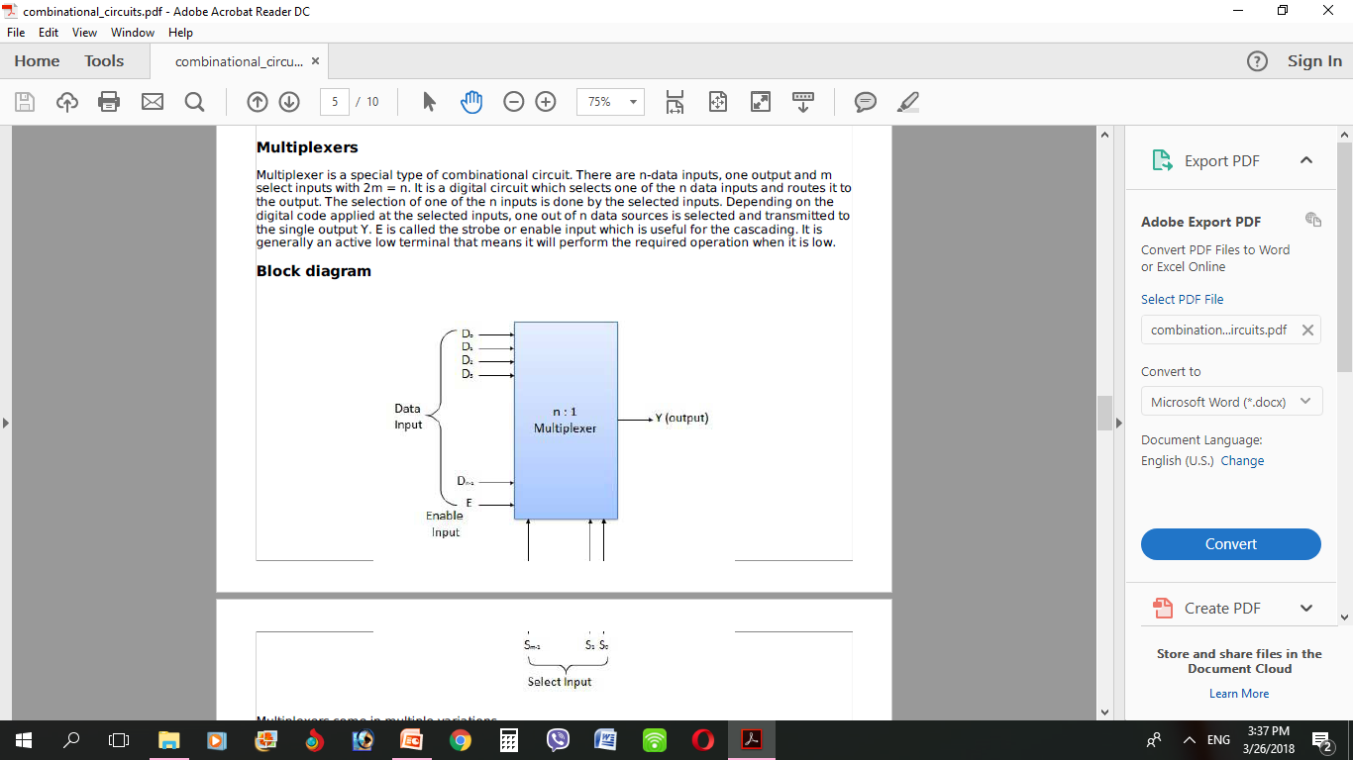
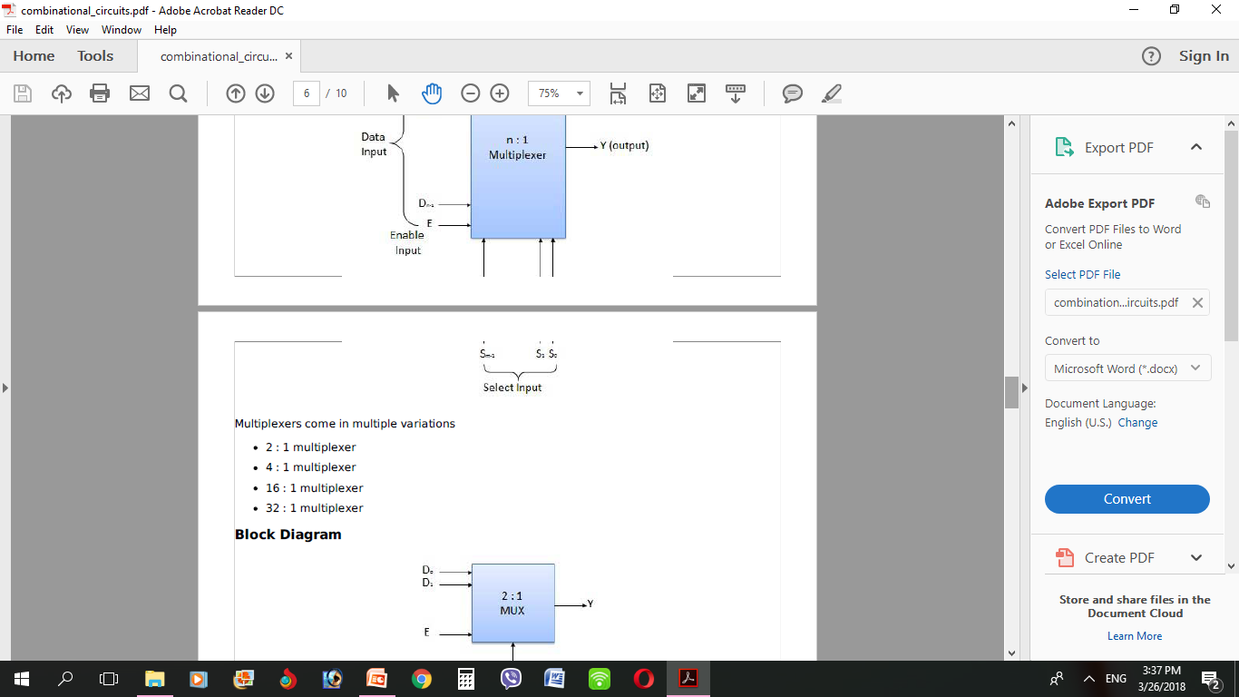
Multiplexer
In electronics, a multiplexer or mux is a device that selects one of several analog or digital input signals and forwards the selected input into a single line. A multiplexer of 2^{n} inputs has n select lines, which are used to select which input line to send to the output. An electronic multiplexer can be considered as a multiple-input, single-output switch i.e. digitally controlled multi-position switch. The digital code applied at the select inputs determines which data inputs will be switched to output.

Slide 2
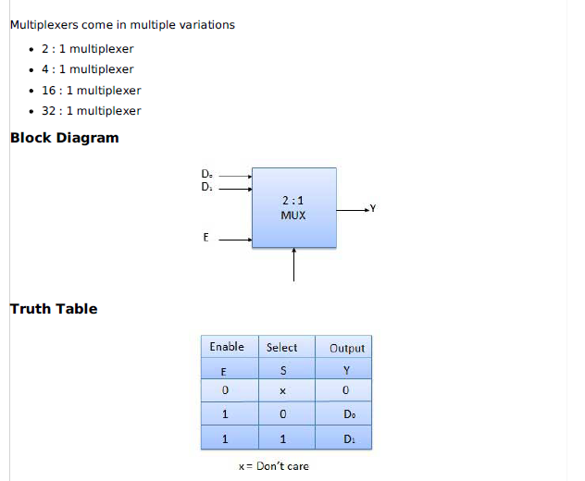

Slide 3
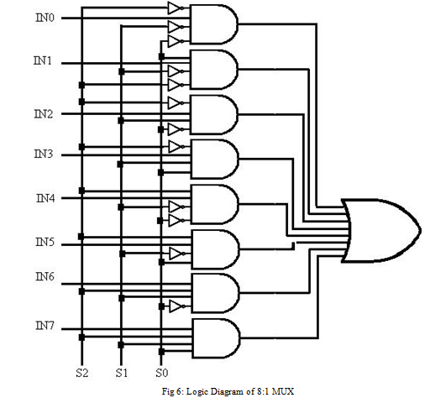
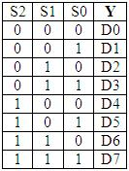
A common example of multiplexing or sharing occurs when several peripheral devices share a single transmission line or bus to communicate with computer. Each device in succession is allocated a brief time to send and receive data. At any given time, one and only one device is using the line. This is an example of time multiplexing since each device is given a specific time interval to use the line.
D0
D1
D2
D3
D4
D5
D6
Table 5: Truth Table of 8:1 MUX
D7

Slide 4
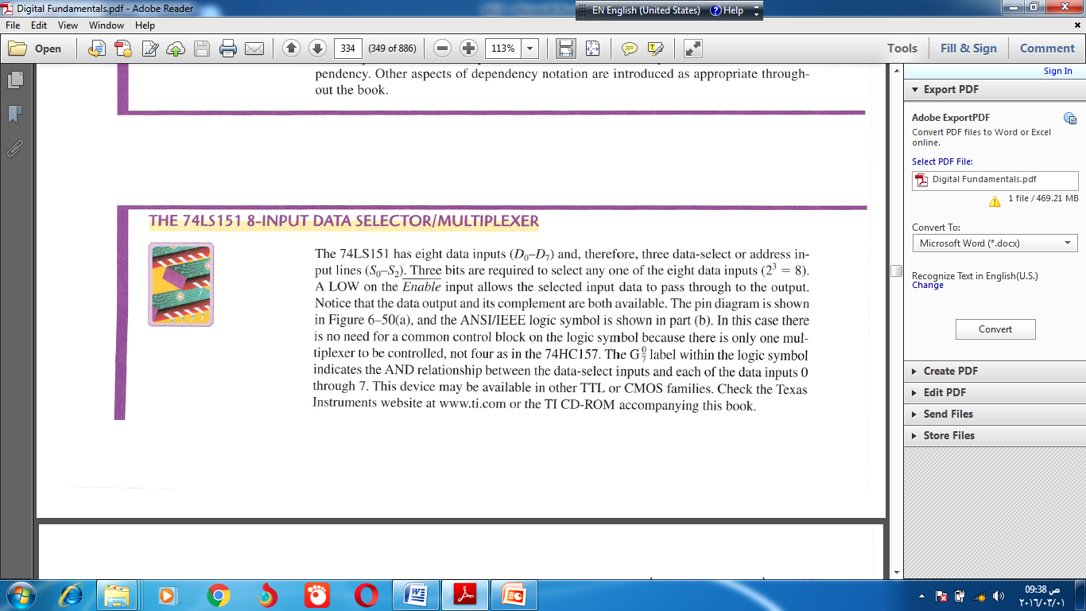
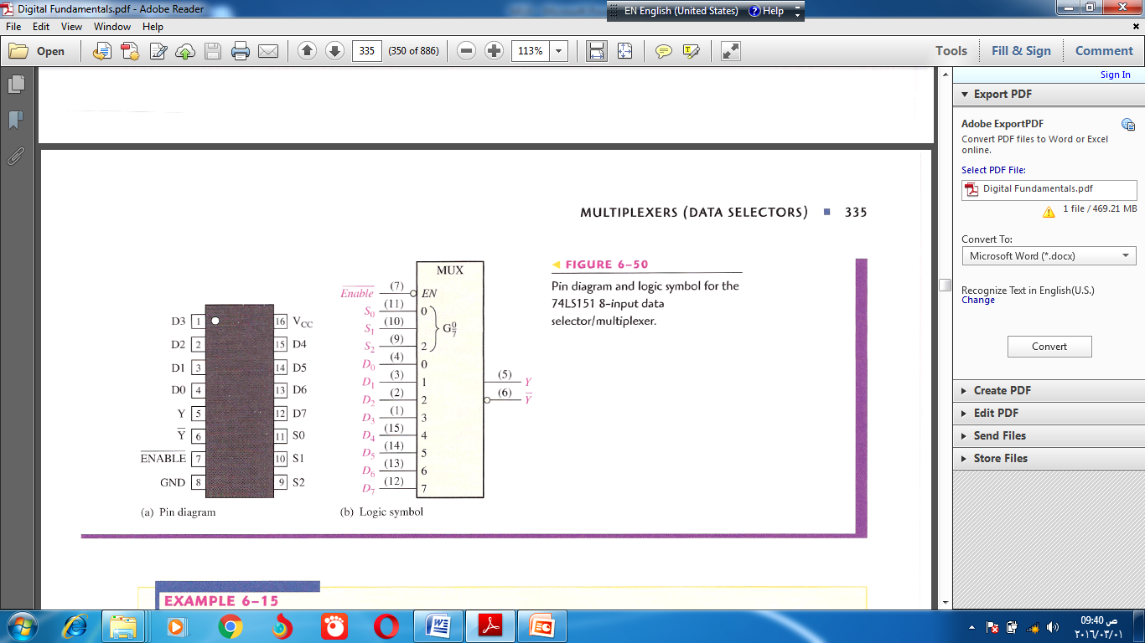

Slide 5
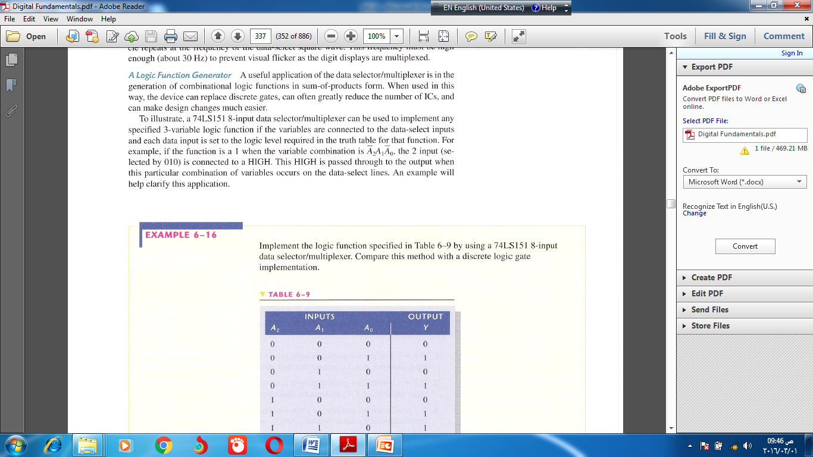

Slide 6
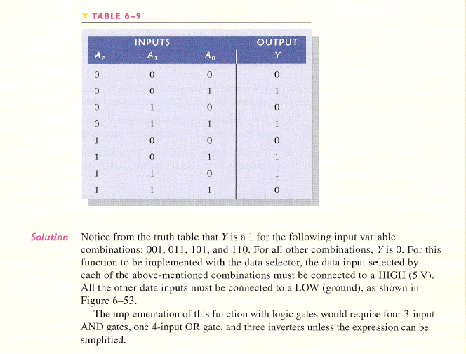

Slide 7
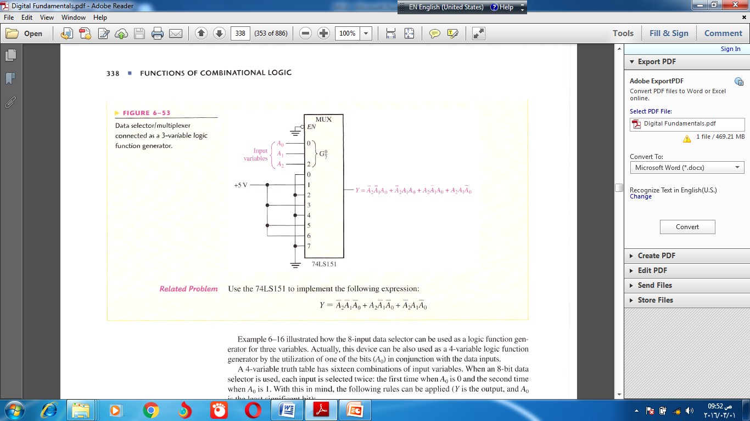

Slide 8
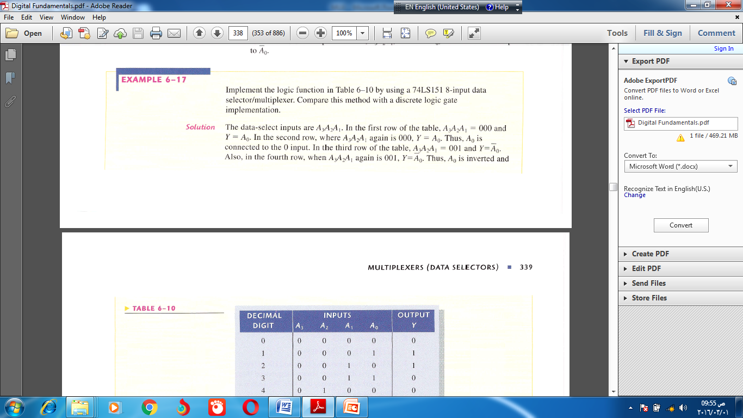
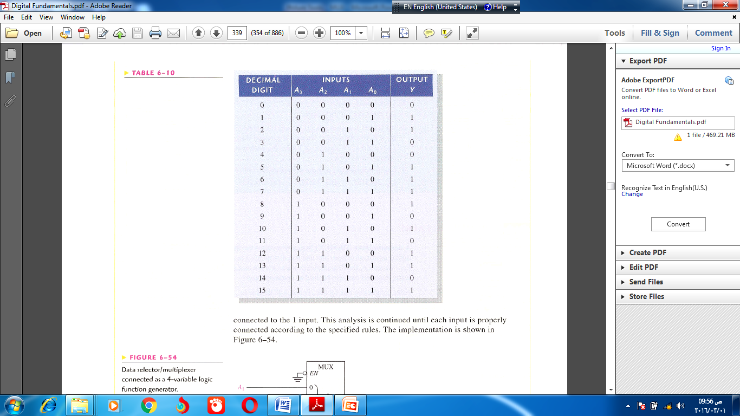

Slide 9
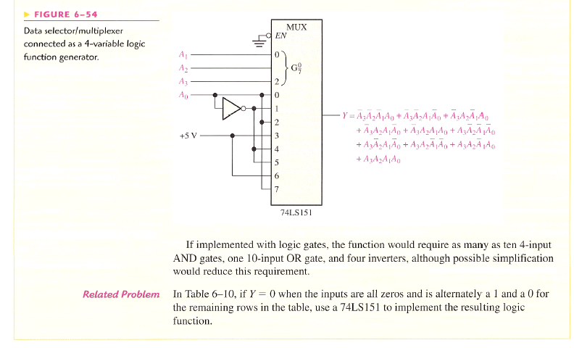

Slide 10


